Slide 1
Dayananda Sagar University
School of Engineering
Devarakaggalahalli, Harohalli Kanakapura Road, Dt, Ramanagara, Karnataka 562112
Department of Computer Science & Engineering
(Artificial Intelligence & Machine Learning)
FULL STACK DEVELOPMENT
SEMESTER – IV
Unit-2

Slide 2
Syllabus
UNIT – II
Introduction to CSS: CSS syntax ,Cascading effect, Specificity, Combining and layering selectors, Backgrounds and gradients, CSS resets, The box model, Positioning with floats, Creating a grid structure, Precise Positioning, Basic website clone.

Slide 3
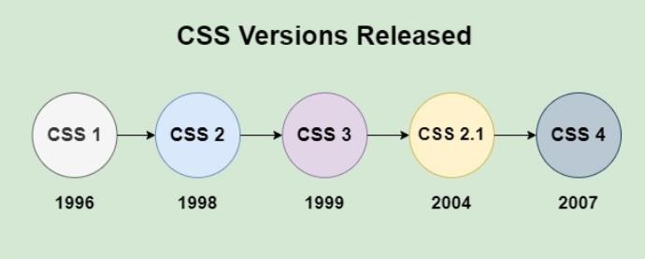
Introduction to CSS
CSS (Cascading Style Sheets) is the language we use to style an HTML document. CSS describes how HTML elements should be displayed.
Using CSS, we can control the color of the text, the style of fonts, the spacing between paragraphs, how columns are sized and laid out, what background images or colors are used.
CSS can control the layout of multiple web pages all at once.

Slide 4
Introduction to CSS
The need for developing CSS (Cascading Style Sheets) arises from the limitations of HTML in terms of presentation and layout. CSS was created to solve these issues and provide several benefits:
Separation of Content and Presentation: HTML is used to structure the content of a webpage, while CSS is responsible for the design and layout. This separation allows for cleaner and more maintainable code, making it easier to update and manage websites.
Consistency Across Pages: With CSS, the style of multiple pages can be controlled from a single stylesheet, ensuring a consistent look and feel across an entire website. This simplifies updates since changes to the CSS file are reflected on all associated pages.
Improved Page Load Times: CSS reduces the amount of code needed in HTML files, as the same styles can be applied to multiple elements or pages. This leads to smaller file sizes and faster page loading times.
Enhanced User Experience: CSS enables the use of responsive design techniques, which help webpages adapt to different screen sizes and devices. This is essential in creating mobile-friendly websites, improving the overall user experience.

Slide 5
Greater Design Flexibility: CSS offers more advanced design options compared to HTML. Developers can control elements such as fonts, colors, spacing, positioning, and animations, allowing for more visually appealing and interactive websites.
Accessibility: CSS aids in making websites more accessible. By separating the content from the design, developers can ensure that screen readers and other assistive technologies can read and
interpret content more effectively.
CSS Syntax:
Following is the syntax of styling using CSS.
style1
{
color: blue; font-size: 16px;
background-color: lightgray;
}
selector
{
property: value;
}

Slide 6
Selector: CSS selectors are used to select the HTML element or groups of elements you want to style on a web page.
Property: A CSS property is an aspect or characteristic of an HTML element that can be styled or modified using CSS, such as color, font-size, or margin.
Value: Values are assigned to properties. For example, color property can have value like red, green etc.

Slide 7
Cascading effect
There are three ways of inserting a style sheet:
External CSS
Internal CSS
Inline CSS
1) Inline CSS
An inline style may be used to apply a unique style for a single element. To use inline styles, add the style attribute to the relevant element.
<!DOCTYPE html>
<html>
<body>
<h1 style="color:blue;text-align:center;">This is a heading</h1>
<p style="color:red;">This is a paragraph.</p>
</body>
</html>

Slide 8
2) Internal CSS
The internal style sheet is used to add a unique style for a single document.
It is defined in <head> section of the HTML page inside the <style> tag.
Rules defined using this syntax will be applied to all the elements available in the document.
<!DOCTYPE html>
<html>
<head>
<style>
body {background-color: linen;} h1 {
color: maroon; margin-left: 40px;
}
</style>
</head>
<body>
<h1>This is a heading</h1>
<p>This is a paragraph.</p>
</body>
</html>

Slide 9
3) External CSS
The <link> element can be used to include an external stylesheet file in your HTML document. An external style sheet is a separate text file with .css extension.
You define all the Style rules within this text file and then you can include this file in any HTML document using <link> element.
style.css
body
{
background-color: green;
}
h1
{
color: blue; font-size: 20px;
}
<html>
<head>
<link rel="stylesheet" href="style.css">
</head>
<body>
<h1>This is a heading</h1>
<p>This is a paragraph. </p>
</body>
</html>

Slide 10
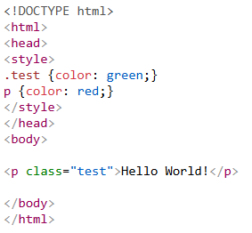

Specificity
What is Specificity?
If there are two or more CSS rules that point to the same element, the selector with the highest specificity will "win", and its style declaration will be applied to that HTML element.
Think of specificity as a hierarchy that determines which style declaration is ultimately applied to an element.

Slide 11
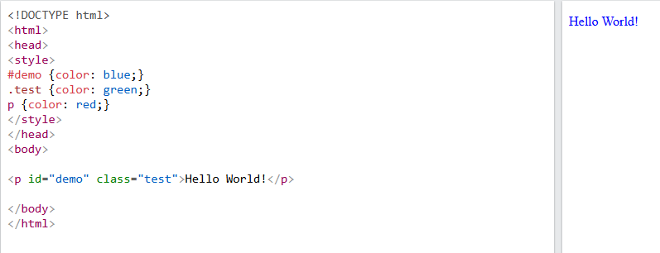
Specificity

Slide 12
Combining and layering selectors
Grouping Selectors (,)
Child Selector (> )
Adjacent Sibling Selector (+)
General Sibling Selector (~)
Layering with Specificity

Slide 13
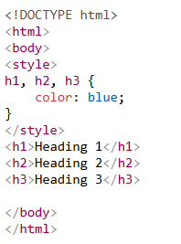
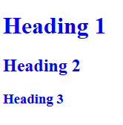
Combining and layering selectors
Grouping Selectors (,)
Applies the same styles to multiple elements at once.

Slide 14
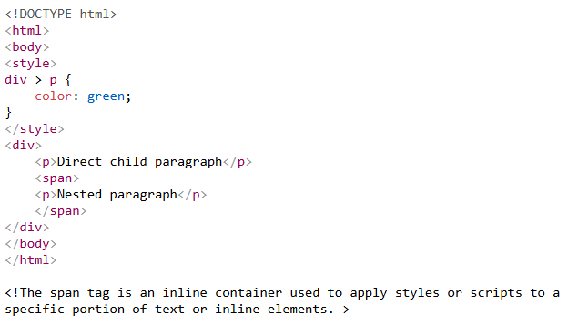

Combining and layering selectors
Child Selector (> )
Selects direct children only.

Slide 15
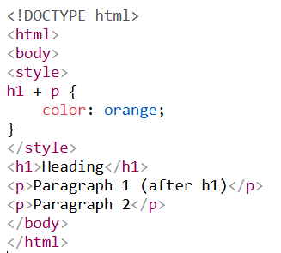
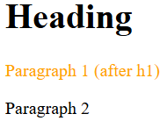
Combining and layering selectors
Adjacent Sibling Selector (+)
Selects an element that is immediately after another.

Slide 16
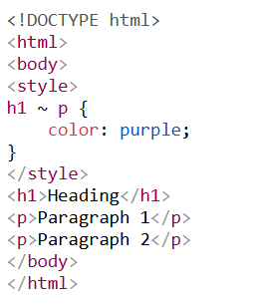
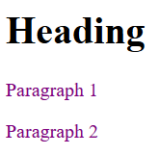
Combining and layering selectors
General Sibling Selector (~)
Selects all siblings after a specific element.

Slide 17
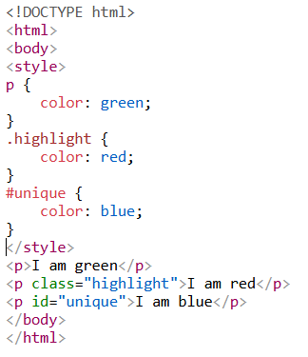
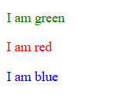
Combining and layering selectors
Layering with Specificity
More specific selectors override less specific ones.

Slide 18
Backgrounds
CSS background property is used to define the background effects on element/page. There are 5 CSS background properties that affects the HTML elements:
Background Property | Description
background-color | h1 { _{body} background-color: green; } { background-color: lightblue; _{div {} } background-color: lightblue; } p { background-color: yellow; } Defines the background color of an element using color We can set the background color for any HTML elements: The opacity property specifies the opacity/transparency of an element. It can take a value from 0.0 - 1.0.

Slide 19
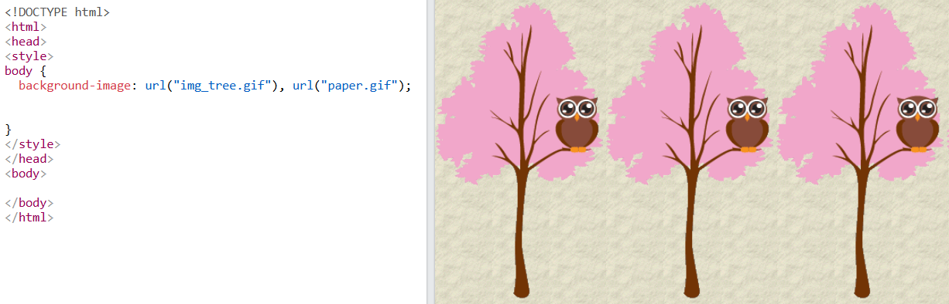
Backgrounds

Slide 20
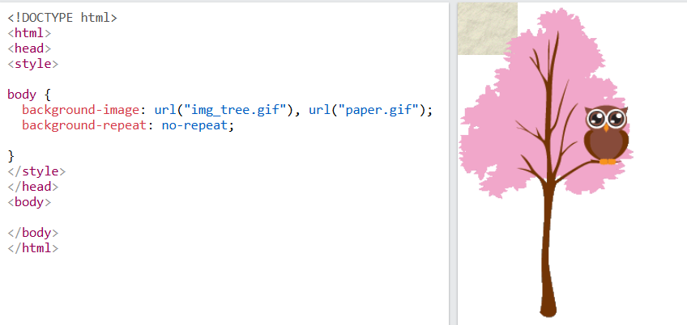
Backgrounds

Slide 21
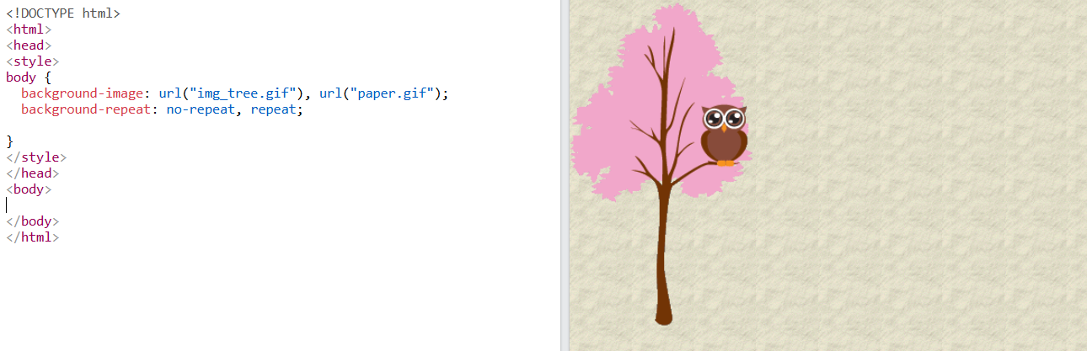
Backgrounds

Slide 22
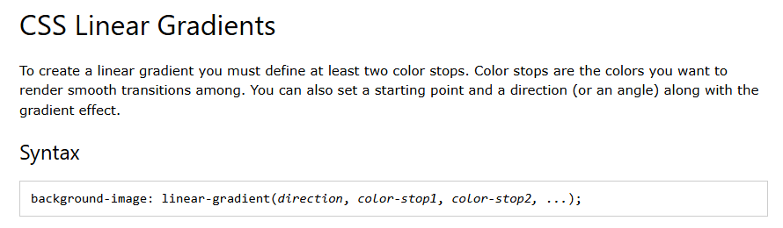
CSS Gradients
CSS gradients let you display smooth transitions between two or more specified colors.
CSS defines three types of gradients:
Linear Gradients (goes down/up/left/right/diagonally)
Radial Gradients (defined by their center)
Conic Gradients (rotated around a center point)

Slide 23
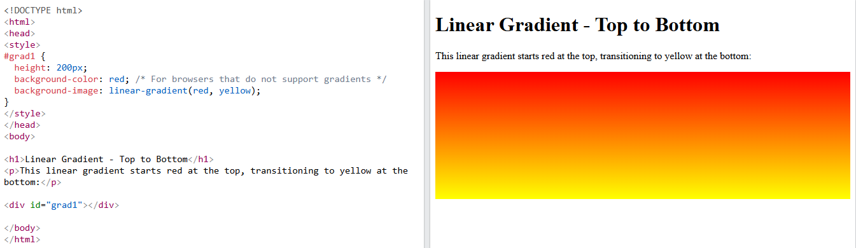
CSS Gradients

Slide 24
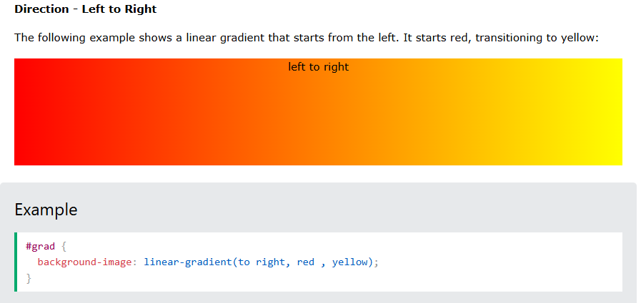
CSS Gradients

Slide 25
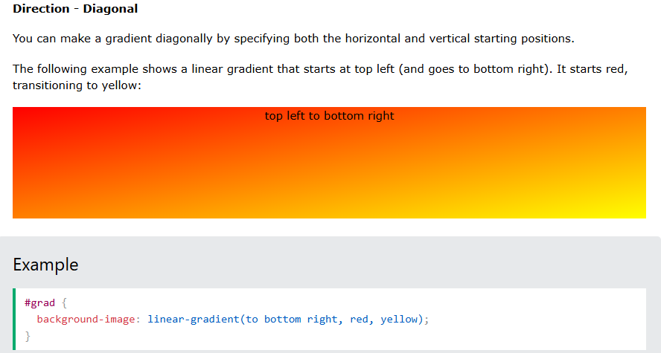
CSS Gradients

Slide 26
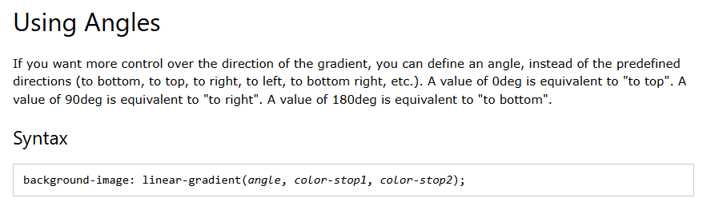
CSS Gradients

Slide 27
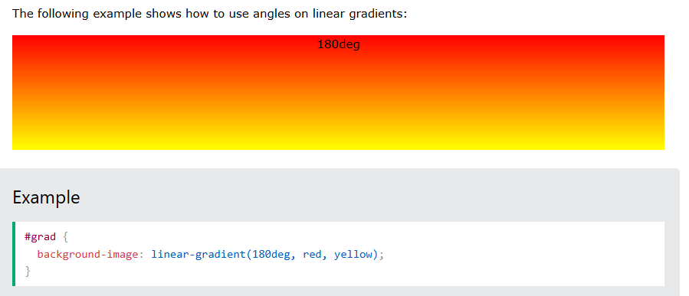
CSS Gradients

Slide 28
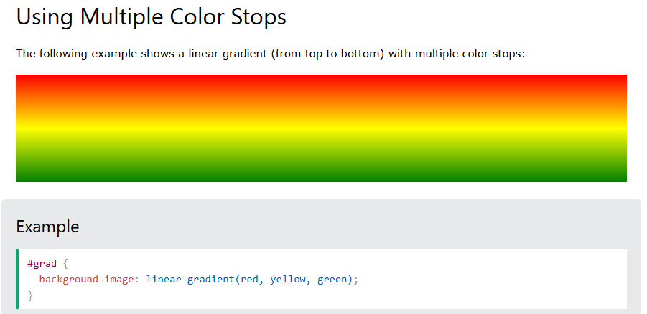
CSS Gradients

Slide 29
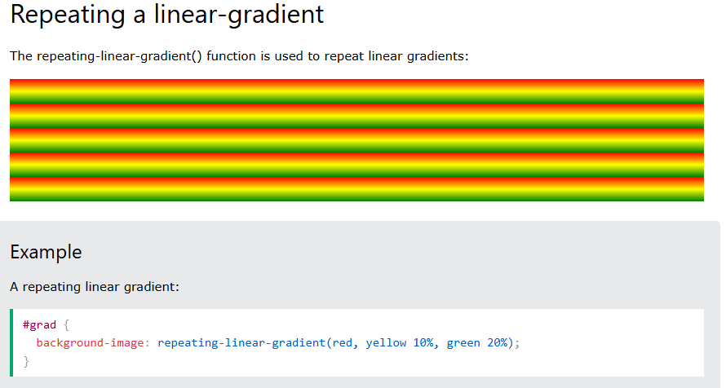
CSS Gradients

Slide 30
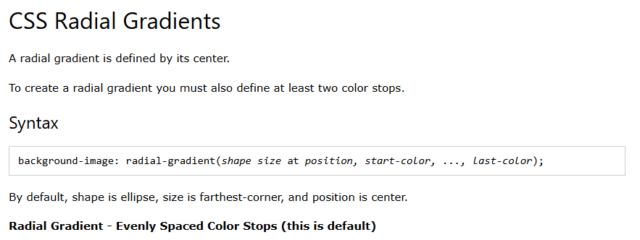
CSS Gradients

Slide 31
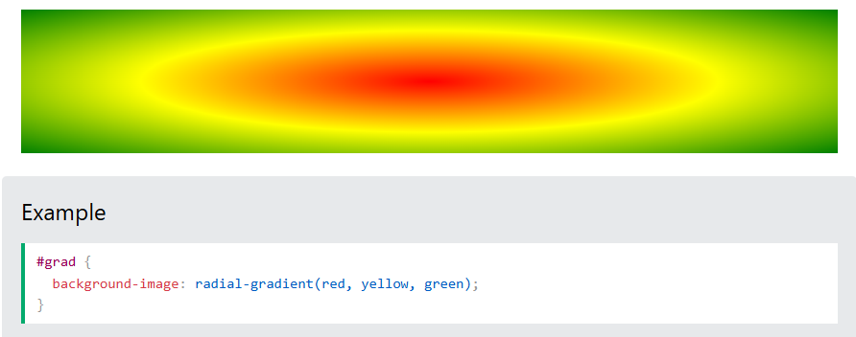
CSS Gradients

Slide 32
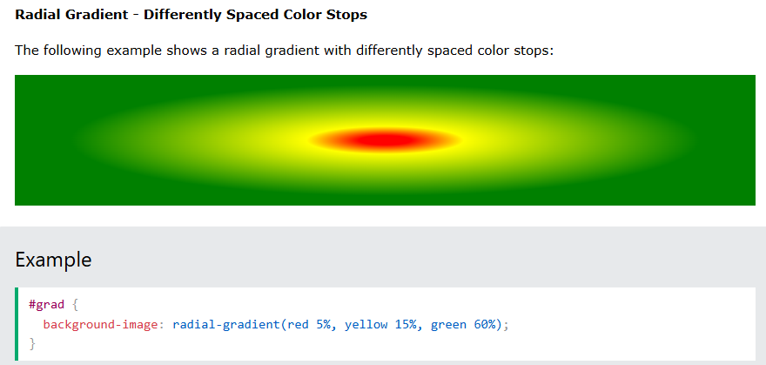
CSS Gradients

Slide 33
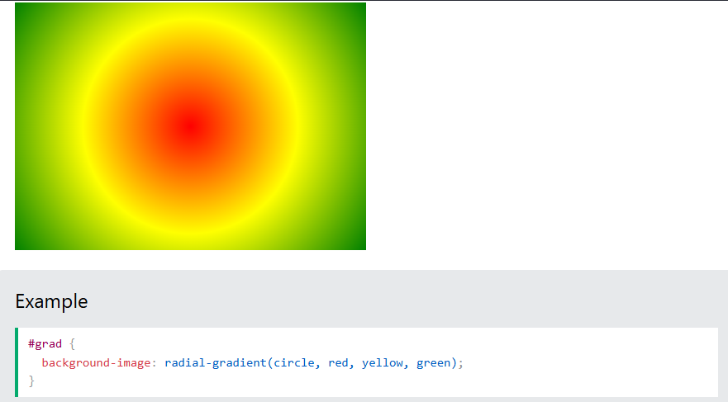
CSS Gradients

Slide 34
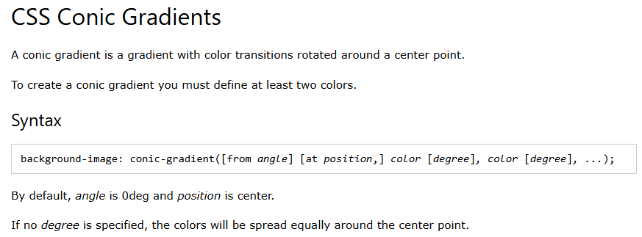
CSS Gradients

Slide 35
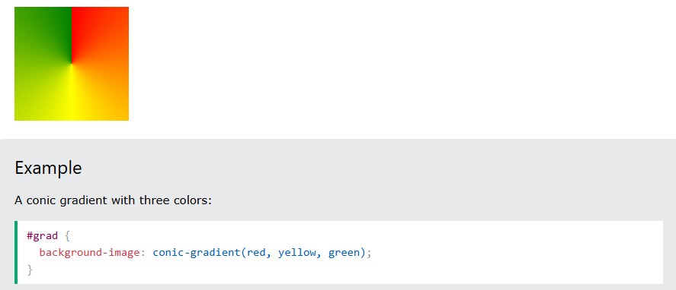
CSS Gradients

Slide 36
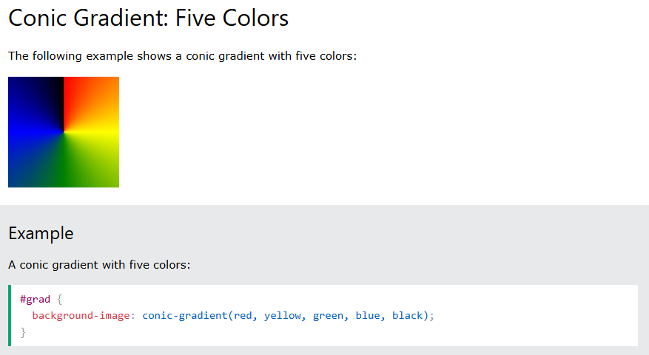
CSS Gradients

Slide 37
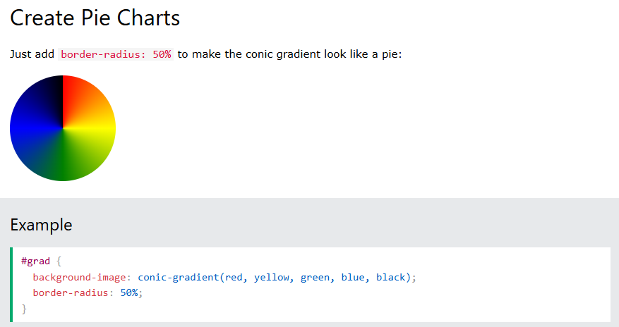
CSS Gradients

Slide 38
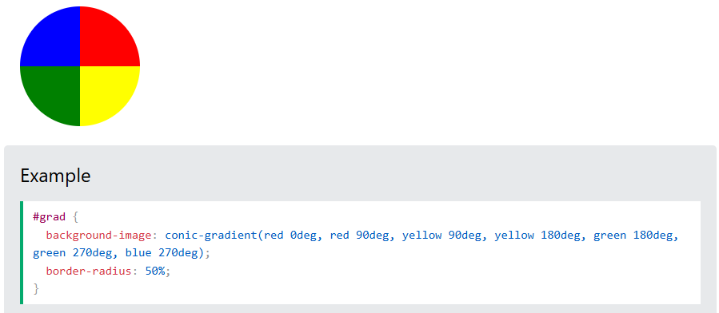
CSS Gradients

Slide 39
CSS Resets
A CSS reset is a technique used in web development to remove or normalize the default styles applied by web browsers.
Different browsers (Chrome, Firefox, Edge, Safari, etc.) have their own default styling for HTML elements, which can lead to inconsistencies in how a webpage is displayed.
A CSS reset ensures that all elements start with the same baseline styles, making it easier to apply consistent custom styles.

Slide 40
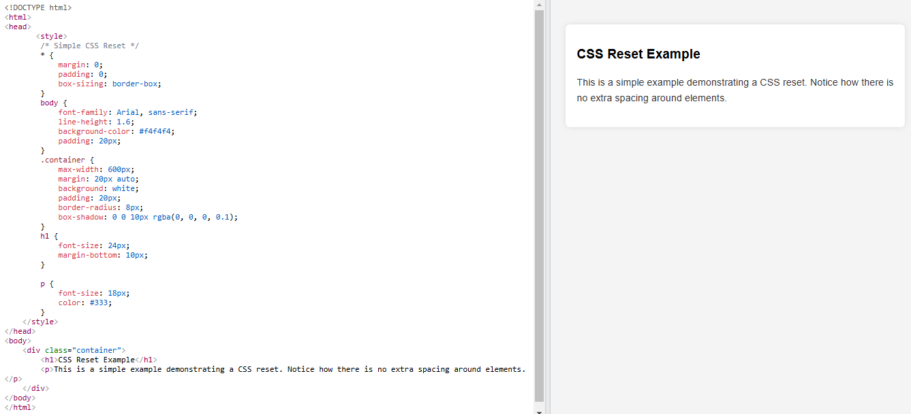
CSS Reset

Slide 41
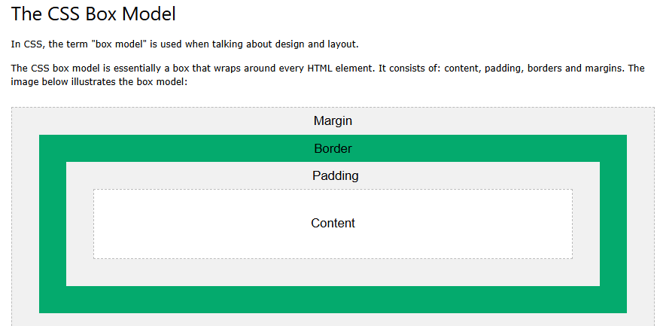
BOX Model

Slide 42
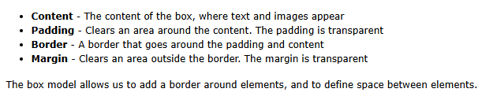
BOX Model

Slide 43
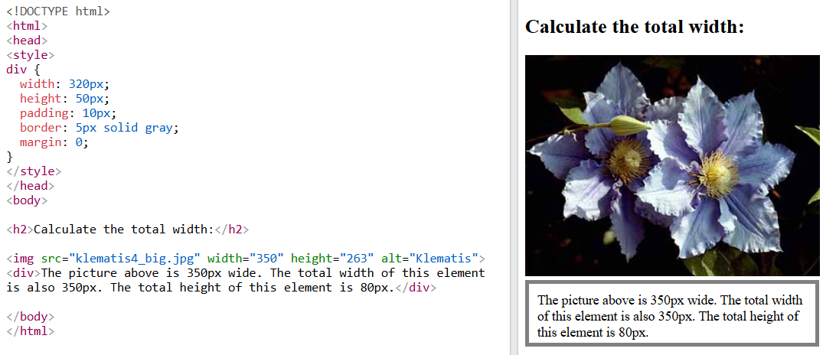
BOX Model

Slide 44
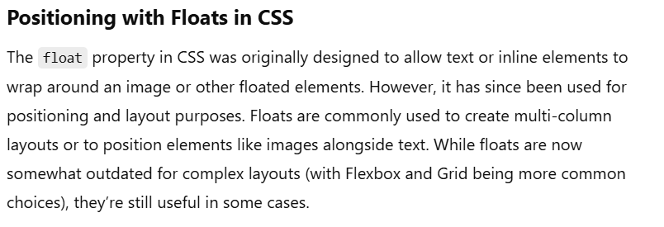
CSS Positioning

Slide 45
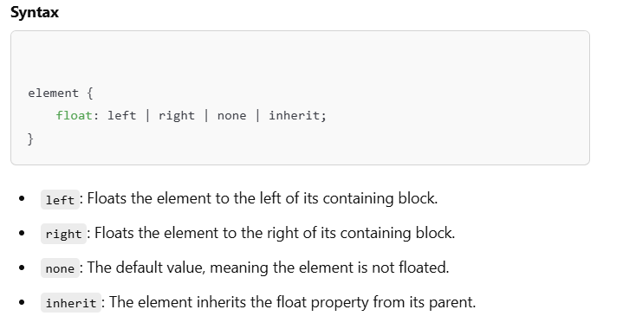
CSS Positioning

Slide 46
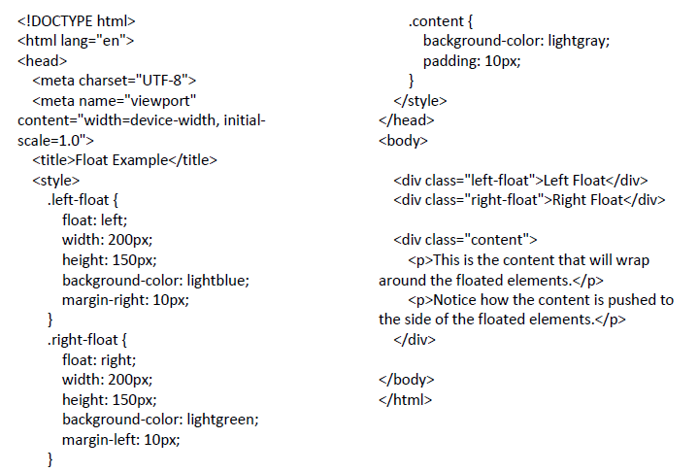
CSS Positioning

Slide 47
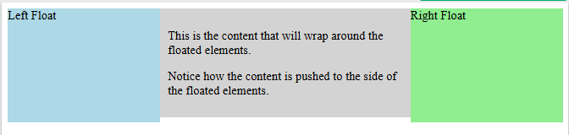
CSS Positioning

Slide 48
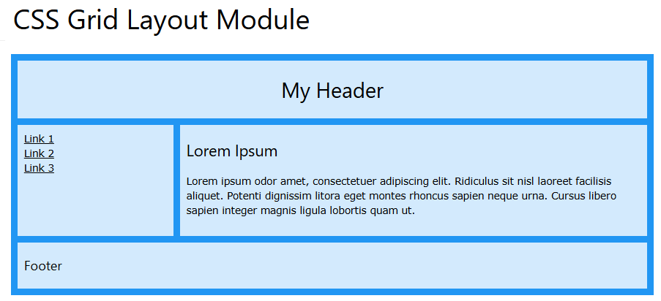
CSS GRID

Slide 49
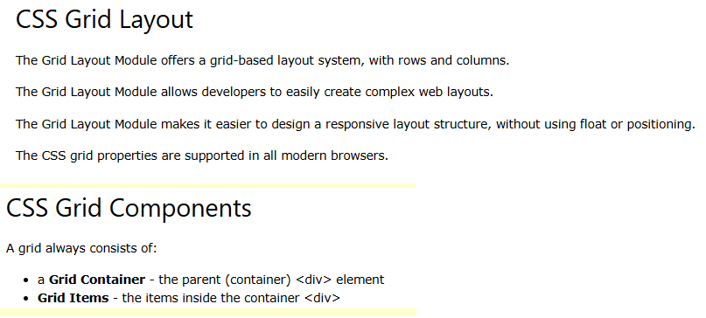
CSS GRID

Slide 50
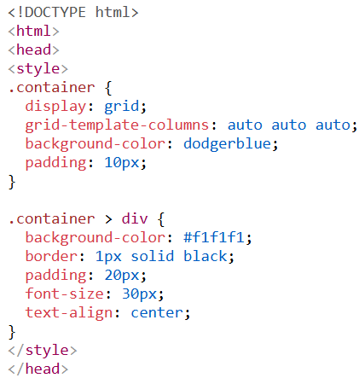
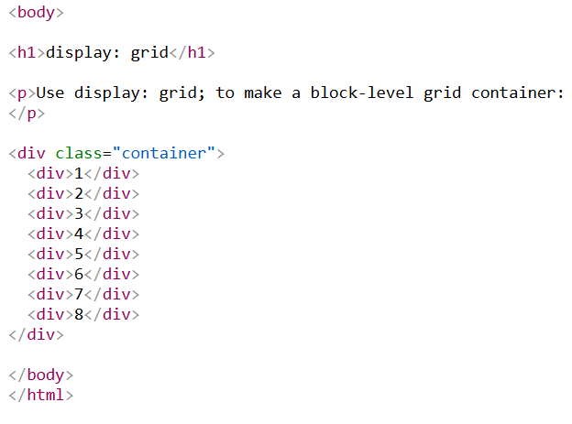
CSS GRID

Slide 51
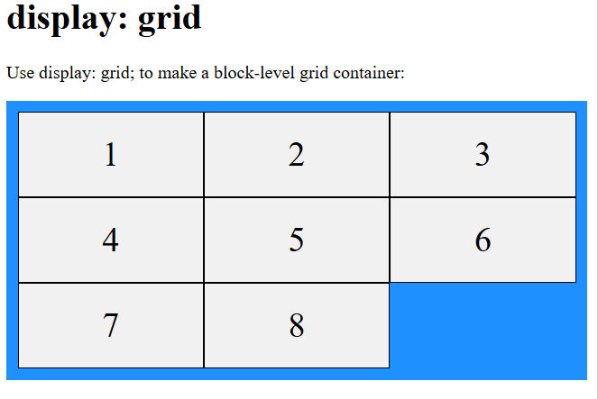
CSS GRID

Slide 52
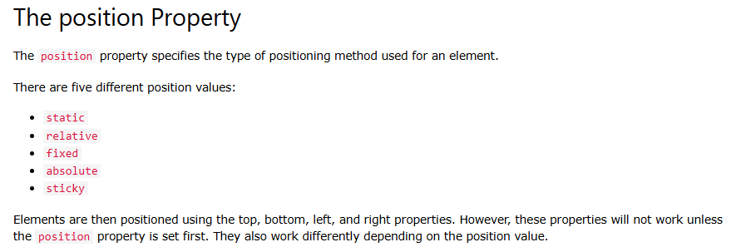
CSS Precise Positioning
The position property specifies the type of positioning method used for an element (static, relative, fixed, absolute or sticky).

Slide 53
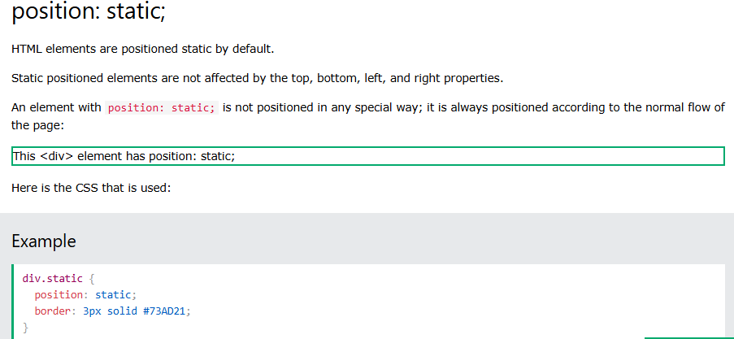
CSS Precise Positioning

Slide 54
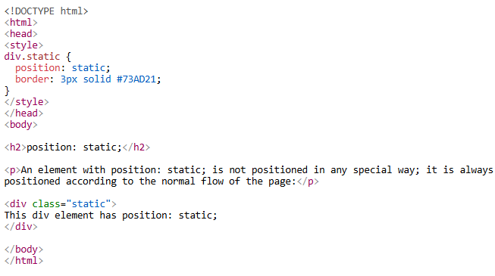
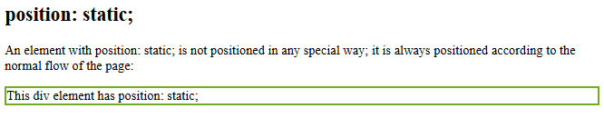
CSS Precise Positioning

Slide 55
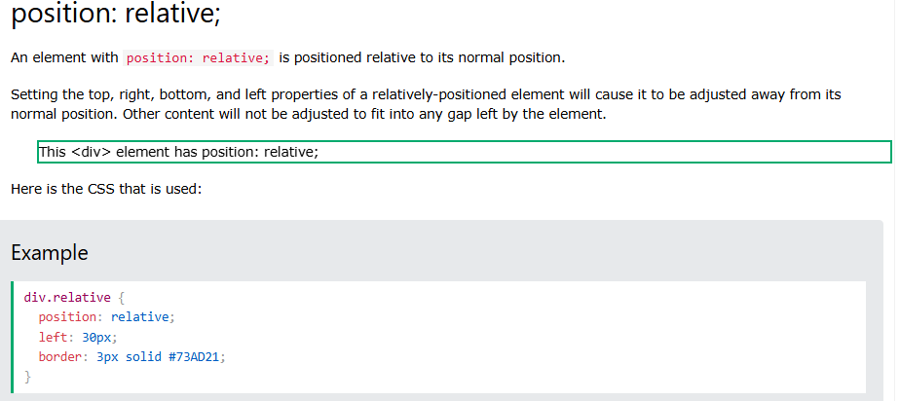
CSS Precise Positioning

Slide 56


CSS Precise Positioning

Slide 57

CSS Precise Positioning

Slide 58

CSS Precise Positioning

Slide 59

CSS Precise Positioning

Slide 60

CSS Precise Positioning

Slide 61

CSS Precise Positioning

Slide 62

CSS Precise Positioning

Slide 63
THANK YOU

